Slide 1

Nova
Scotia
Growth
Resource
Optimization
Workflow
Kanav Bhardwaj |Abhiroop Yerramilli Yakov Fainshtein|Matthew Carl
Notes:
matt

Slide 2
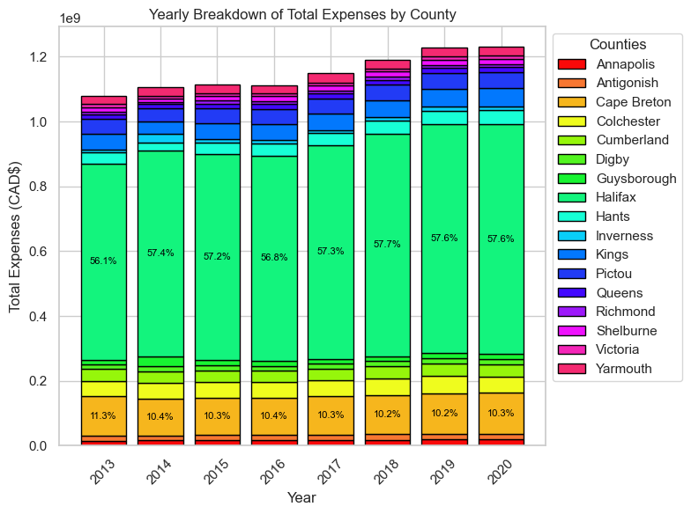
1. Problem Details
Background
Provincial expenses continue to rise
Problem Statement
Our goal is to help the leaders of municipalities in Nova Scotia predict expenses of each county in all sectors for a coming year to allow attention to be directed to those high expenditure and areas, to avoid surpassing those predicted expenditure values.
Importance
Small Expense fluctuations are great amounts of money
Potential for Immense Savings
Notes:
Matt
Background Municipalities around the world, rely on efficient resource allocation for sustainable development, growth, innovation, and community well-being. Proper resource allocation is essential. It necessitates data-driven approaches to address challenges and information on important fiscal decisions,
Our project addresses the critical need for effective resource allocation in Nova Scotia's municipalities, aiming to ensure economic and social well-being by introducing a tailored predictive tool for expenditure forecasting, mitigating risks of overspending, economic stagnation, social inequality, and environmental issues, thus enhancing fiscal foresight and promoting long-term prosperity.
Graph:
Breakdown of total NS expenditures per year by county
Trends seem constant, however one percentile on the graph equates to 10 mil
Lots of potential money to be saved.

Slide 3
2. Project Details
Objectives
Predict High Expenditure counties for a coming year
Scope
Primarily data within the bounds of Nova Scotia
Achieve a RMSE ~ 10% of mean
Use of some national indicators (GDP, Inflation)
Model only to be used by municipal leaders of Nova Scotia.
Complete Preprocessing
Determine Best Split
Complete Modelling
Notes:
Matt
Objectives:
Scope:
This tool is not intended for use outside of Nova Scotia
Complete Preprocessing:
- Output Util Splitting:
Modelling:

Slide 4
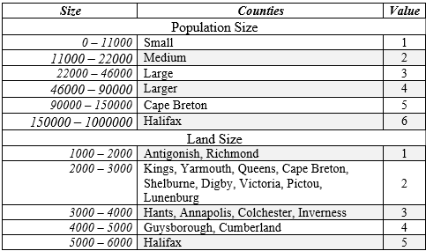
3. Data Details
Binning Breakdown
Data Collection
Annual County-wise Municipal Fiscal Statistics
Worldbank GDP indicators
Statistics Canada Annual Population and Tax Data
2016 & 2021 Canadian Census Data
Data Stats
54 Features: 2 Categorical + 52 Continuous
137 Data Points
Data Preparation
Filtering Range of Years
Grouping Data by County
Dropping
&
Combining Features
Binning
Notes:
Matt
Filtering range of years
Grouping data by county
Dropping/Combining features
Equal interval binning

Slide 5
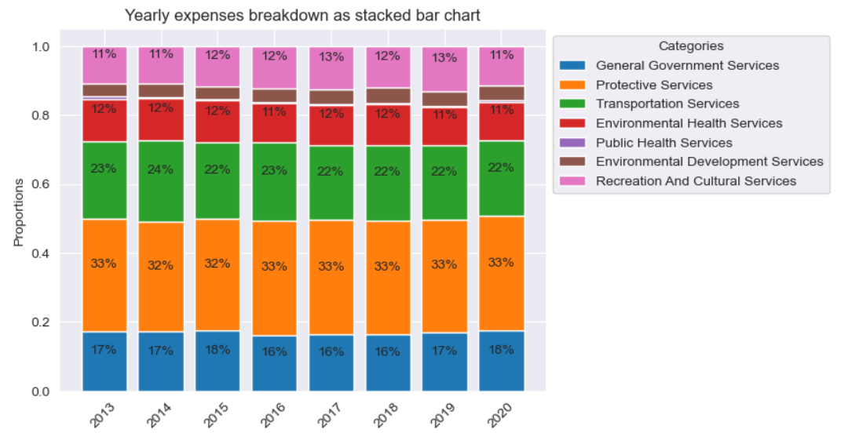
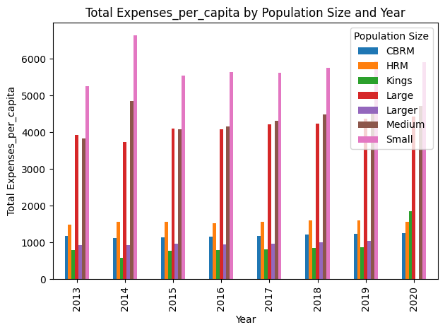
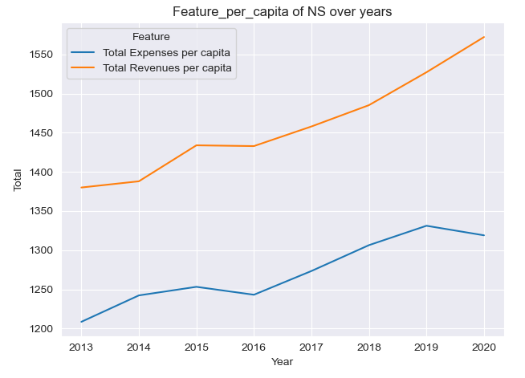
4. Dataset Insights
1
2
Total
Expenses Breakdown
3
4

Slide 6
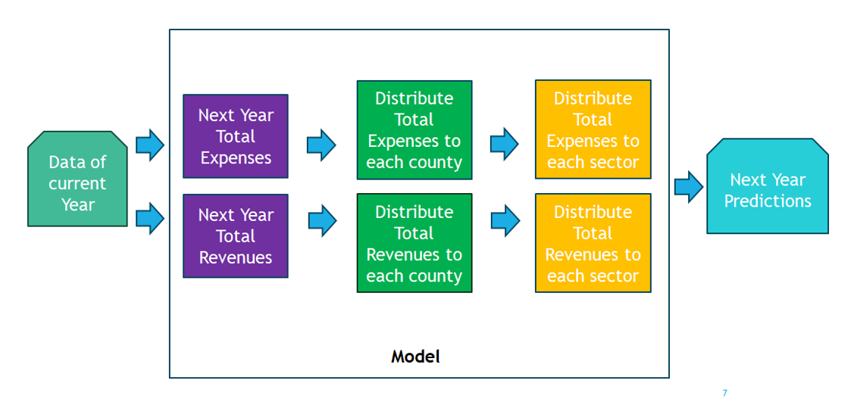
5. Modelling
Model 1: Linear Model (see appendix)
Assuming linear relationship
Log features
Model 2: GBM
Ensemble model
Small Dataset
Common Features
Training and Validation splits:
5-fold time series split
Split by year
Evaluation Metrics
RMSE
R²
Percent error
Residuals
Linear Model Layout
Notes:
Yakov: gbm

Slide 7
6. Results
Evaluated for year 2020
Region | Percentage error comparison
 | Linear Model | Gradient Boosting machine
Annapolis | 1.429911 | 2.814188
Antigonish | 9.617876 | 5.150445
Cape Breton | 2.105211 | 17.353712
Colchester | 0.271547 | 3.174709
Cumberland | 3.896207 | 1.524529
Digby | 5.568142 | 1.185751
Guysborough | 1.161470 | 6.083862
Halifax | 0.925060 | 3.136256
Hants | 1.255302 | 5.955603
Inverness | 61.852759* | 4.970773
Kings | 0.936483 | 5.399633
Pictou | 22.682610 | 1.318797
Queens | 14.268579 | 4.295345
Richmond | 9.597485 | 1.148223
Shelburne | 1.066063 | 1.879644
Victoria | 3.429221 | 3.527608
Yarmouth | 5.040955 | 0.782363
RMSE | $ 3,805,472 | $ 6,703,723
Average Error | 8.89 % | 4.65 %
Weighted Mean Expenses: $ 21,827,238 Total Expenses: $ 1,230,868,649
Notes:
yakov

Slide 8
7. Key Findings
Implications
Accurate expenditure forecasts
Facilitating data-driven policy decisions
Limitations
Limited future prediction
Trained on limited data
Interpretation
Fairly Accurate Model
Can handle variance
Notes:
abhiroop

Slide 9
8. Conclusion
Predicting using governmental fiscal data
Trends in the ratios
Can only predict one year in advance
Not much data but with a linear fit
GBM and Linear Regression
High R² value and acceptable RMSE
Help counties with resource allocation
Notes:
abhiroop

Slide 10

Questions

Slide 11
Appendix
Fitted Model
Evaluation Plots
Correlation Map
11

Slide 12
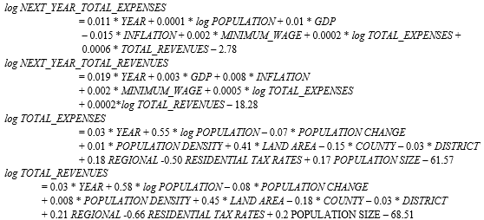
Fitted Model

Slide 13
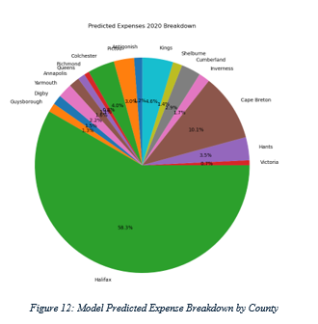
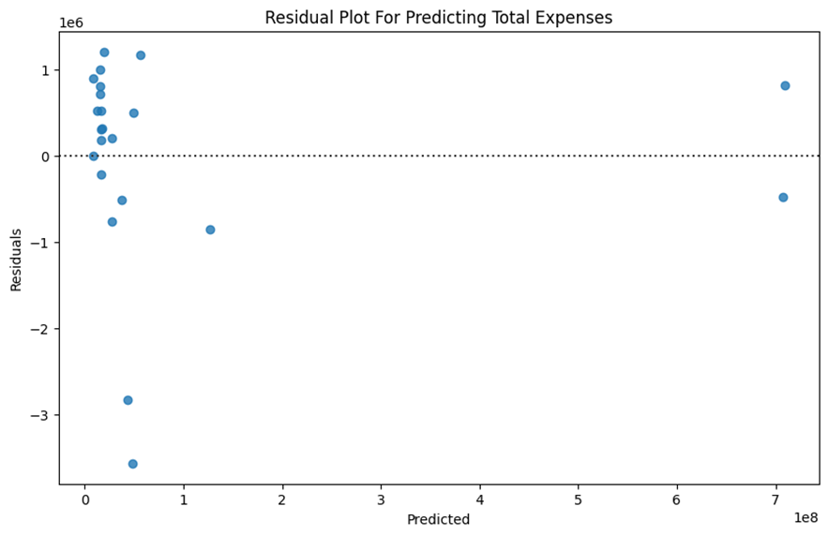
Evaluation Plots

Slide 14
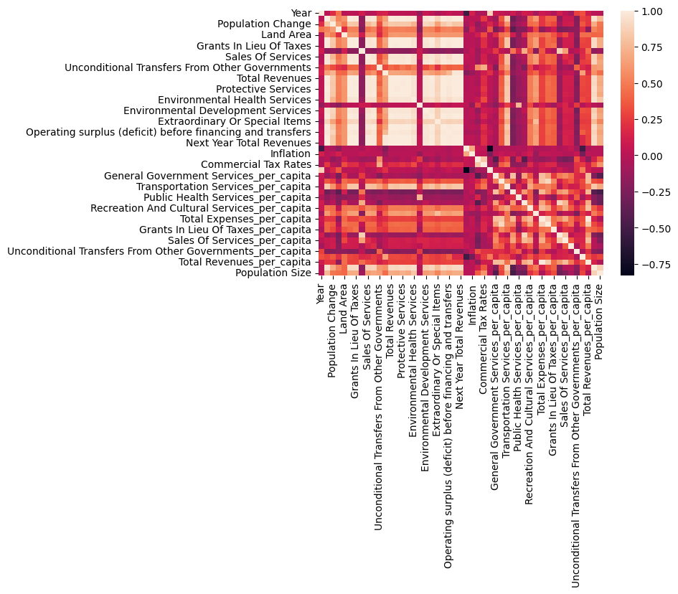
Correlation Map

